Slide 1
OOPS
IN
PYTHON

Slide 2
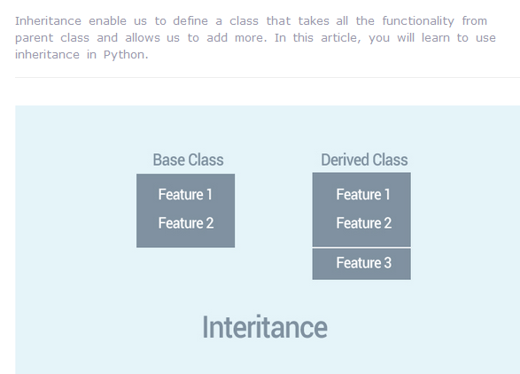

Slide 3
Instead of starting from scratch, you can create a class by deriving it from a preexisting class by listing the parent class in parentheses after the new class name.
The child class inherits the attributes of its parent class, and you can use those attributes as if they were defined in the child class. A child class can also override data members and methods from the parent.

Slide 4
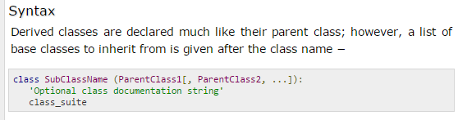
The Syntax is:

Slide 5
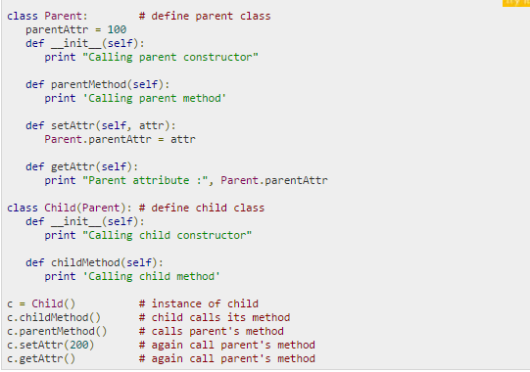

Slide 6
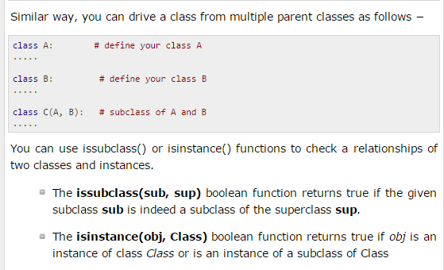

Slide 7
Overriding Methods
You can always override your parent class methods. One reason for overriding parent's methods is because you may want special or different functionality in your subclass.

Slide 8
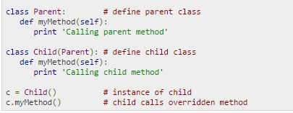
Example

Slide 9
class A(object):
def foo(self):
print 'A'
class B(A):
def foo(self):
print 'B'
super(B, self).foo()
class C(A):
def foo(self):
print 'C'
super(C, self).foo()
class D(B,C):
def foo(self):
print 'D'
super(D, self).foo()
d = D()
d.foo()

Slide 10
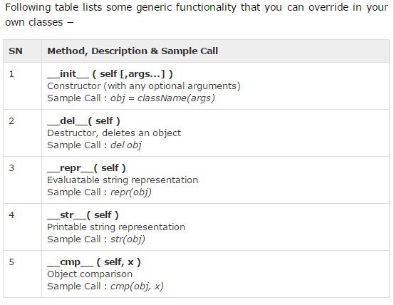
Base Overloading Methods

Slide 11
Overloading Operators
Suppose you have created a Vector class to represent two-dimensional vectors, what happens when you use the plus operator to add them? Most likely Python will yell at you.
You could, however, define the __add__ method in your class to perform vector addition and then the plus operator would behave as per expectation

Slide 12
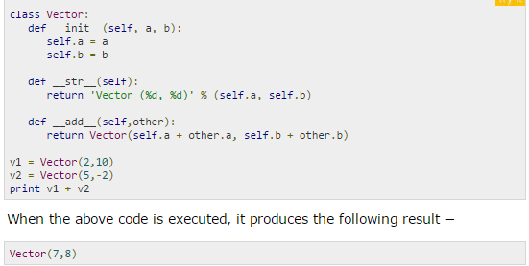
Example

Slide 13
Data Hiding
An object's attributes may or may not be visible outside the class definition. You need to name attributes with a double underscore prefix, and those attributes then are not be directly visible to outsiders.

Slide 14
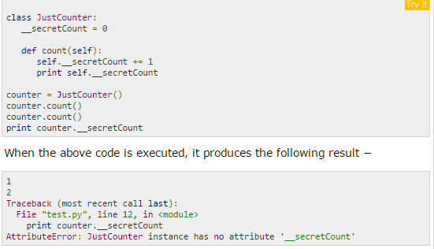

Slide 15
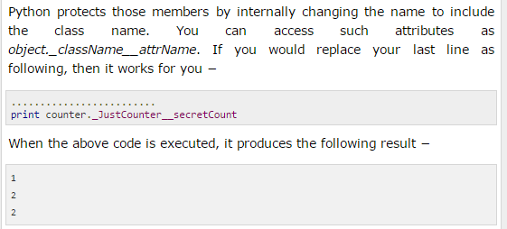

Slide 16
Questions1(Account Class)
Design the class name account that contains:
  A private id for account
  A private balance for account
  A private intrate for annual interest rate
  A constructor that creates an account with specified id, initial balance and interest rate.
  A method name getmonthlyinterestrate() that return monthly interest rate.
  A method name checkbalance() that return balance amount from the account.
  A method name withdraw() that withdraws a specified amount from the account.
  A method name deposite() that deposits a specified amount to the account.
  == Create 10 accounts with initial balance 100 and rate of interest 4%.
  ==The system prompts the user to enter account ID, if it is correct open a main menu having chaises
  1. Check balance, 2. withdraw, 3. deposit and 4. exit.

